Slide 1




Prediction
Ctrl
A reliable tool for analysing and forecasting
Global AI Hackathon
#BuildwithAI : Emergence
#challenge_predictive_algorithm

Slide 2
Problem - COVID 19
Limited knowledge about the growing corona cases
Inadequate management of resources
Non-availability of reliable forecasting tool
Inaccessibility of data dervied decision making tool

Slide 3
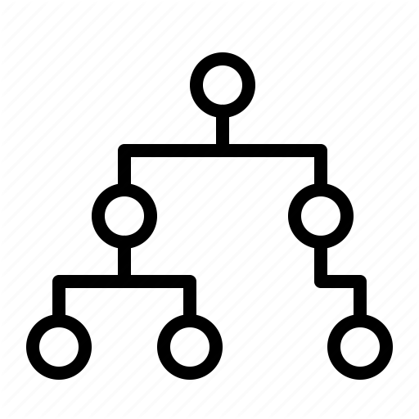


Solution
VISION : To enhance the society by helping businesses and clients to make faster and smarter decision through our tool.
A tool which helps in decision making process
A tool which help in visualization
Solution that fulfill the need of society by predicting the future needs

Slide 4

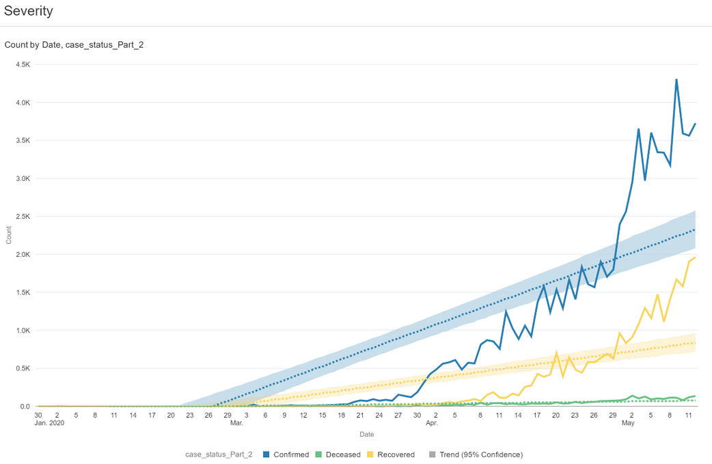
Our Product
Covid-19 Cases Severity
COVID-19 Cases Severeity
Prediction Ctrl
A reliable tool for analysis and forecasting

Slide 5
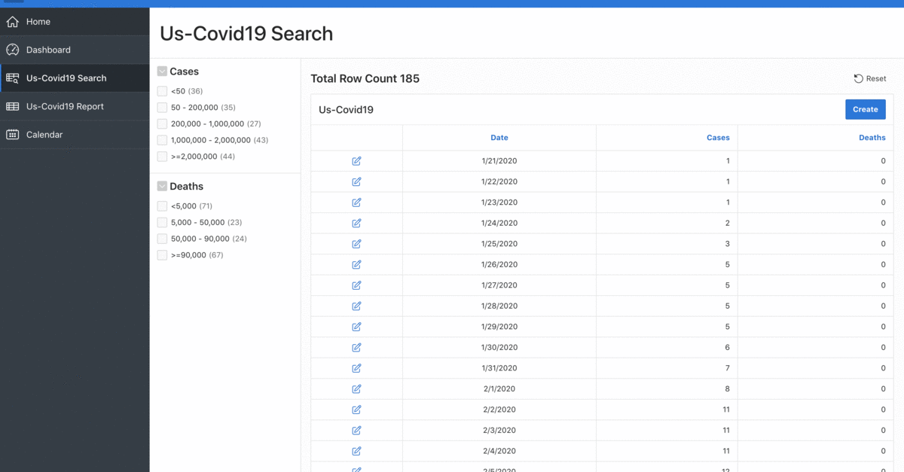
US COVID-19 Dashboard

Slide 6
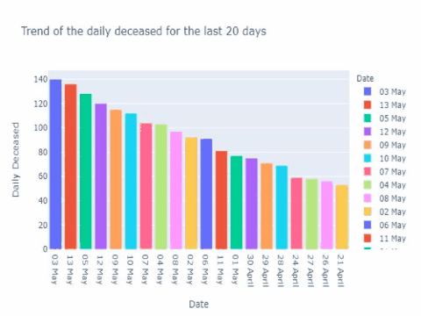
US COVID-19 Analysis

Slide 7



Technologies
Oracle Cloud
Amazon Web Service
Google Colab
Oracle Apex/Analytics

Slide 8
Target Market
Other Industries
9.1%
Healthcare & Medical
22.7%
Business services
9.1%
Advertising & Marketing
9.1%
Retail
9.1%
Transportation & Logistics
18.2%
E-commerce
4.5%
Government
4.5%
Startups
9.1%
Source :https://www.goodfirms.co/company/beyond-analysis/focus

Slide 9






Competitive Advantages
Delivered on time
Reliable Services
Time based Subscriptions
Highly Accurate Results
On-demand Services
Best Price

Slide 10

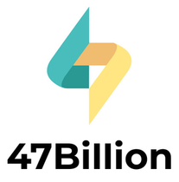


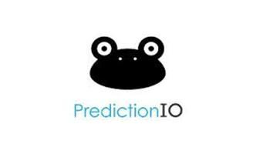
Competitors
Market Adoption
Partnerships/VCs & Government Funds
Create Public Awareness through marketing
Incentivize user for referral

Slide 11




Business Model
Most popular plan
$100/mon
Monthly subscription
services & Freemium
$999
Additional on-demand services available. (i.e) Customization according to customer preferences.
Plan
Selling SDKs & APIs

Slide 12


Future Roadmap
Next steps to enhance the model and achieve better accuracy
Deploy to market
Product Customization
Expand Market

Slide 13
Future Roadmap
Next steps to enhance the model and achieve better accuracy
Step 1
Step 2
Step 3
Step 4
1
2
3
4
Idea
Modelling
Include more parameters
train the model

Slide 14



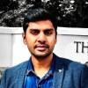

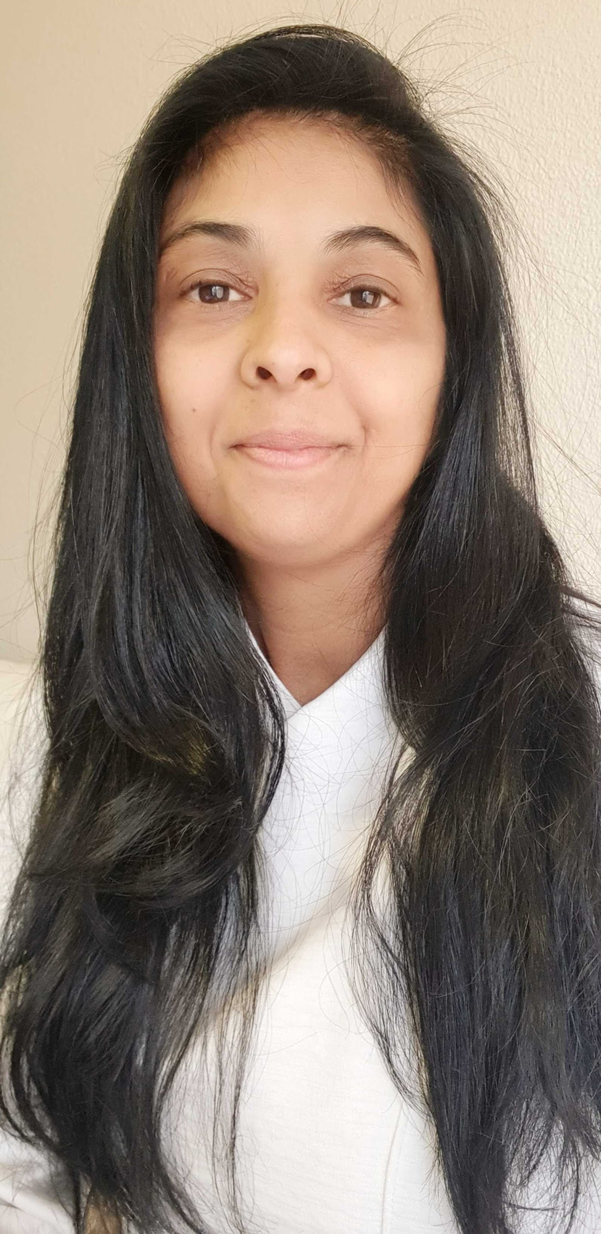
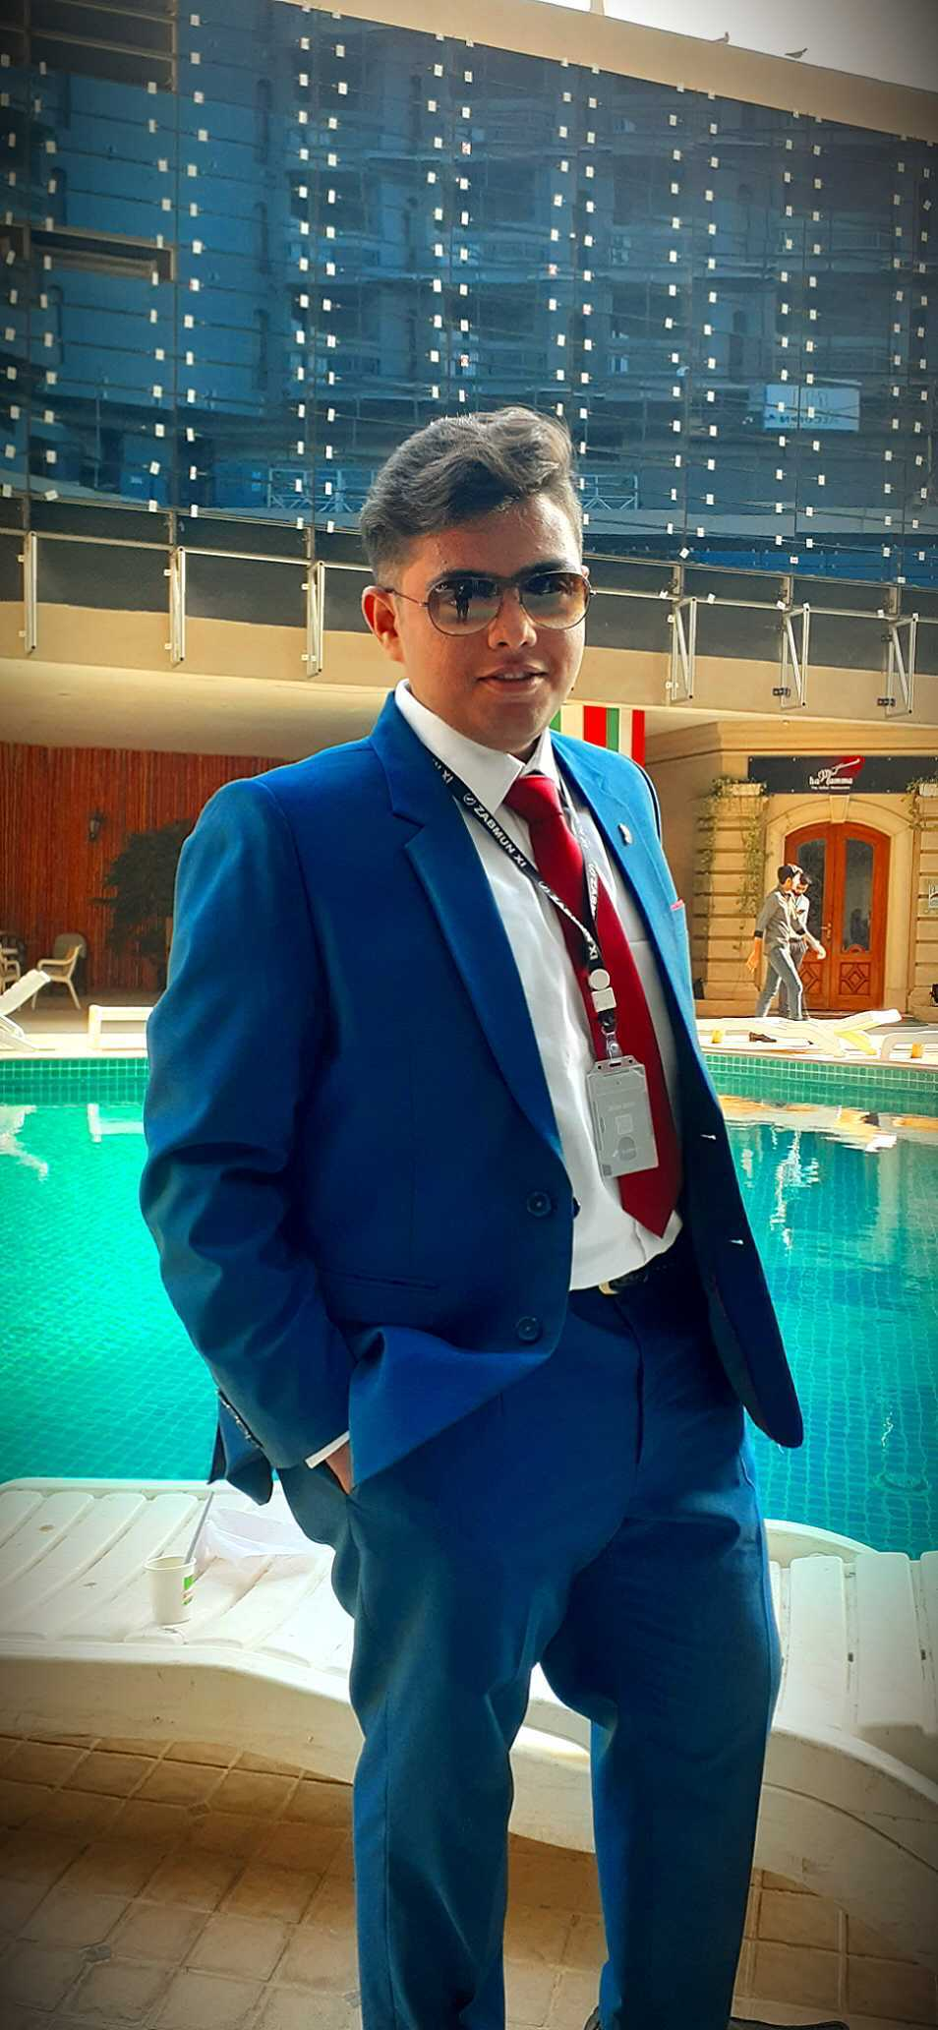
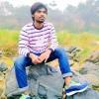
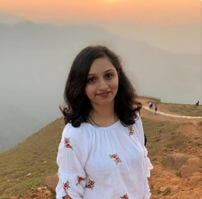



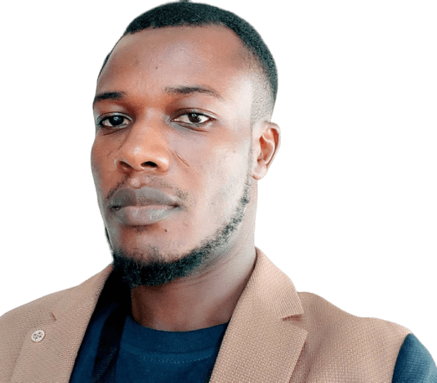
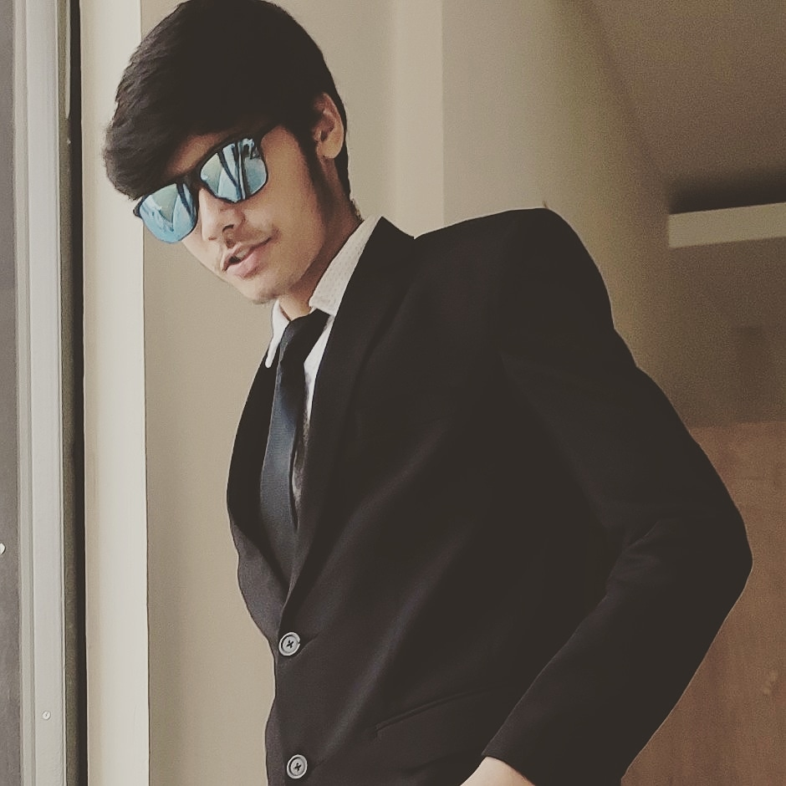
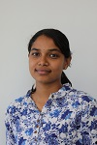
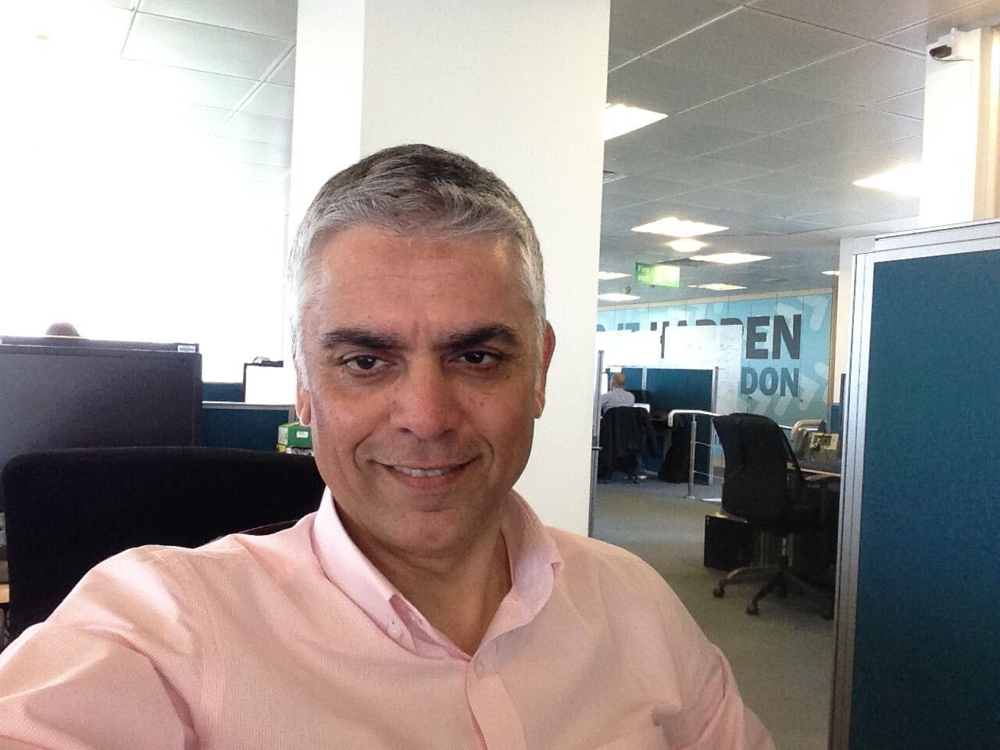

Our Diverse Team
Syed Mustafa
Irfan Mansuri
Mahabir Gupta
Dehlia Redker
Lavina
Presenter
Business Member
Software Engineering Member
Lead Mentor
Subject Matter Expert
Franklyn Ogbonna
Tanuj Dhiman
Shenaha Sivakumar
Saif Hague
Software Engineering Member
Project Manager
Team Representative
Lead Mentor

Slide 15
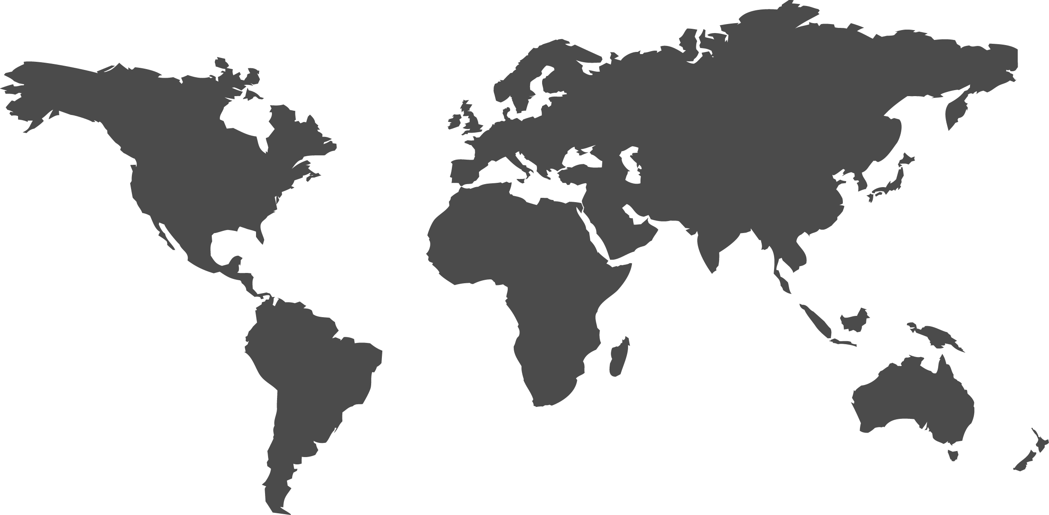


Slide 16



























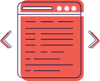

Free Resources
Use these free, recolourable icons and illustrations in your Canva design.

